Slide 1
Chapter 8 Plane Electromagnetic Waves
Wuqiong Luo

Slide 2
Contents
8.1 Plane Waves in Lossless Media
8.2 Plane Waves in Lossy Media
8.3 Flow of Electromagnetic Power and the
Poynting Vector
8.4 Normal Incidence at a Plane
Conducting Boundary
8.5 Normal Incidence at a Plane
Dielectric Boundary

Slide 3
8.1 Plane Waves in Lossless Media
3
Related concepts
1）Amplitude
2）phase
time phase
space phase
Argument
Initial Phase
3）Equal-phase Surface
4）Equal-Amplitude
Surface
Basic Issues
Time-harmonic field
Infinite single media space
EM wave propagation
Related concepts
In passive region
Complex vector contains the changes
of field quantities at any time in space

Slide 4

4
Problems
Analysis of Time-harmonic EM Wave
The law of the field quantities change with spatial location
The law of the field
quantities change with time
√ Plane Wave Cylindrical wave
Spherical wave
(The complex vector functions of fixed time)
Linear polarized wave
Circular polarized wave Elliptical polarized wave
(A fixed position of the instantaneous changes)
√
√
√

Slide 5
5
The definition of uniform plane wave
Plane wave：At any time Equiphase Surface (wavefronts) is a flat sheet (plane)
Uniform：The amplitude of the EM field in the equiphase surface is fixed
Uniform plane wave
The equiphase surface of EM wave is plane, and also the
amplitude of EM field on the equiphase surface is a constant.
Features
Equi-phase surface and Equal-Amplitude Surface of uniform plane wave are coincidence or parallel
The electric field complex vector in equiphase surface(Eqs) is a constant vector
The amplitude and direction of the EM field in equi-phase surface are fixed at any time
Q：At different moments , the EM field in equi-phase surface of uniform plane wave is the same ？

Slide 6
6
The ideal dielectric
Conductive medium

Slide 7
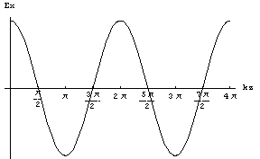
7
1. The Electromagnetic Field of Uniform Plane Wave
Skills: establishing a proper coordinate system ！
take equiphase surface as coordinate plane ,such as x-y plane , thus：
Solution:
then：
The instantaneous expression of the electric field
The EM wave propagate along the
direction of the spatial phase lag

Slide 8
8
Important features
Uniform plane wave is transverse
electromagnetic waves（TEM）
Wavefront
x
E
Wave propagation direction
o
z
y
H
Uniform plane wave

Slide 9
9
Summary
The complex electromagnetic field vector of uniform plane wave that propagating along the z direction can express as ：
Uniform plane wave is transverse electromagnetic waves（TEM wave）
The EM wave propagate along the direction of the spatial phase lagging.

Slide 10
10
Solution for uniform plane wave propagating along arbitrary direction
To assume wave propagation direction:
So that:
For the convenience of said to define new physical quantities, Wave vector:
so
as the same
x
Equiphase surface
x
Equiphase surface
P(x,y,z)
P(x,y,z)
r
e
n
r
direction of wave propagation
direction of wave propagation
o
Z’
z
o
z
y
uniform plane wave propa-
gatiing along +Z direction
uniform plane wave propa-
gatiing along arbitrary direction
y

Slide 11
11
The composition of solution that corresponding UP-wave EM field
For the uniform plane wave propagate along , the expression
for electromagnetic field solutions：
The complex EM field vector：
where wave vector：
The complex amplitude vector
Transient solution of E：
The relationship
between and ?

Slide 12
12
The technique of analyzing uniform plane wave and the EM field
expression using complex amplitude
Solution for EM field expressed using complex amplitude , when uniform plane wave propagating along
Since:
So:

Slide 13
13
The relationship between E and H of uniform plane wave
perpendicular to each other
Electric and magnetic fields in phase
Amplitude difference of times
x
where
E
O
is the intrinsic impedance of the
medium, also called wave impedance
H
y
z
in vacuum
Uniform plane wave in ideal medium

Slide 14
14
Summary for Uniform Plane Wave
Solution for electromagnetic field complex vector ：
The direction of meet the Right-handed Corkscrew Rule
Transverse electromagnetic wave（TEM wave）
The direction of propagation along the space phase lag
Electric and magnetic fields in phase, amplitude difference of times

Slide 15
15
1、Propagation parameters of uniform plane wave
（1）Angular frequency, Frequency and Period
Angular frequency ω ： refers to the change of the phase per unit time, unit: rad /s
Period T ：At the same location, the time interval corresponding
phase change 2π
E
x
o
t
Frequency f ：
T

Slide 16
16
（2）Wave length and Phase constant
Wave length λ ：At the same location, the space interval
corresponding phase change 2πof equiphase surface
Phase constant k： refers to the
change of the phase per unit
distance.（wave number）
E
x
o
z
λ

Slide 17
17
（3）Phase velocity
Phase velocity v：The velocity of equiphase surface moved in space.
As
Get the phase velocity of uniform plane wave is
independent with the
frequency of EM waves
In vacuum ：

Slide 18
18
Summary for Uniform Plane Wave in Ideal Medium
Solution for electromagnetic field complex vector：
The direction of meet the Right-handed Rule;
Transverse electromagnetic wave （TEM wave）
The direction of propagation along the space phase lagging
E and H in phase, amplitude difference of times;
Related physical quantities : frequency、period、wave length、phase constant 、wave number、phase velocity、power velocity

Slide 19
8.1.2 polarization of electromagnetic wave
19
1. The concept of the polarization
2. Linear polarized wave
3. Circular polarized wave
4. Elliptical polarized wave
5. Polarized wave decomposition
6. Application of Polarization

Slide 20
20
The basic problem ：
For time varying electric field ,
at the fixed point ,to study the law of
Electric field change with time, such as
Key points
1：for harmonic field，due to the independent variable of the temporal variation can be separated，i.e. The law of the change of time and space are independent of each other. So ,when studying the law of time variation, the value of ，can take any value, such as :
2： changing over time behave as its magnitude and direction is changing over time
conclusion：
Studying the law of time variation of harmonic field can be in any spatial location.
The study is focus on the change of the trajectory of the vector of the field over time.

Slide 21
21
1. The concept of the polarization
The polarization of wave
At fixed point in the space, the trajectory of the E-field vector varies with time
Analysis method
Vector variation ，behave as the magnitude variation of the vector components;
Study of vector component changes over time，starting from the transient expression of field vector. for plane wave:
conclusion:
The rule of vector end changes over time is depend on the amplitude and initial phase of each component.
Any polarization can be synthesized by linear polarization！

Slide 22
22
The vector end equation
Without loss of generality，consider plane waves that propagate in the +z direction ，the expression is ：
（一） The vector end parametric equations
generally, nonlinear polarization
In rectangular
coordinate system：
In polar coordinates：
（二） The vector end equation

Slide 23
23
The mode of the polarization
Linear polarization
left-hand polarization (+Z)
right-hand polarization (+Z)
right-hand polarization (-Z)
left-hand polarization (-Z)
conclusion: the mode of polarization for EM waves depends on the difference between initial phases of each component

Slide 24
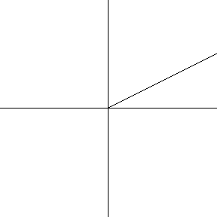
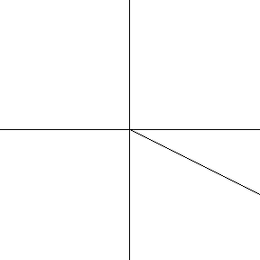
24
2. linear polarized wave
condition： or
time-varying
then the vector parameter equation was simplified：
constant
conclusion：Any two Linear polarized waves with the same frequency and direction of propagation, if their polarization direction perpendicular to each other, can be synthesized to a linear polarized wave, when their phase difference is zero or ±π.

Slide 25
25
3. Circular polarized wave
condition ：
constant
The vector end equation
Left-hand circular polarization wave(LHCP)
Right-hand circular polarization wave(RHCP)
conclusion：Any two Linear polarized wave that the same frequency and direction of propagation, what’s more their polarization direction perpendicular to each other, can be synthesise to circular polarized wave, when their amplitude is the same and their differ phase is ±π/ 2 .

Slide 26
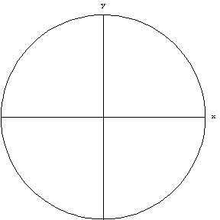
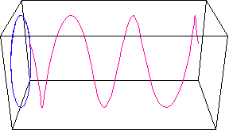
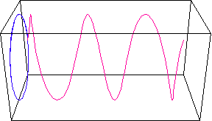
26
right-hand circular polarization wave：
y
E_{y}
E
α
o
E_{x}
x
right-hand circular polarization wave
left-hand circular polarization wave：
y
E
x
o
α
x
E
y
E
left-hand circular polarization wave

Slide 27
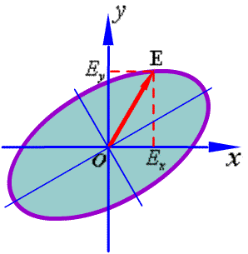
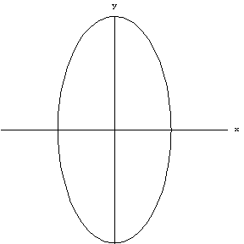
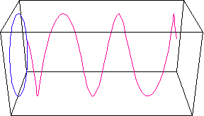
27
4. elliptical polarized wave
Generally

Slide 28
28
Summary of composite polarized wave
The polarized mode of electromagnetic wave is depend on the phase difference(Δφ＝φ_{y}－φ_{x}) and the amplitudes （E_{xm}、E_{ym}) of E_{x}and E_{y} .
modes of polarization
linear polarization：Δφ＝0、±π
Δφ＝0，In quadrant 1, 3；Δφ＝±π ，In quadrant 2,4
circular polarization：Δφ＝±π /2，E_{xm}＝E_{ym}
for the wave in the +z direction :“＋” correspond to LHCP；“－” correspond to RHCP.
elliptical polarization：generally
for the wave in the +z direction : 0 < Δφ < π ，left-hand；－π < Δφ＜0，right-hand.

Slide 29
29
Ex. Illustrate the following uniform plane wave polarization mode.
( 1 )
( 2 )
( 3 )
Answer：
RHCP
（1）
linear polarized wave
（2）
（3）
RH elliptical polarized wave

Slide 30
30
5. Polarized wave decomposition
Any kind of polarization of uniform plane wave can be decomposed into the sum of two linear polarized wave .
Any kind of polarization of uniform plane wave can be decomposed into the sum of right- and left-hand circularly polarized wave, and their amplitude is different.
Prove：
Any linear polarized wave can be decomposed into the sum of right- and left-hand circularly polarized wave, with equal amplitude.

Slide 31
31
· Problems ！
· Analysis Method !
· The associated general
parameters and concepts!
· Typical problem in
application ？

Slide 32
32
6. The engineering application of polarized wave
The polarization is wide used in many fields. such：
In radar target detection technology，Using the characteristics of the polarization changed in the process of electromagnetic scattering to achieve target recognition.
In the radio technology，Using the polarized characteristic of the antenna transmitting and receiving electromagnetic waves, to implement the best performance of radio signals transmitting and receiving.
In optical engineering , the different propagation characteristics of different polarized wave in the same material is used to design optical polarizing film, and so on .

Slide 33
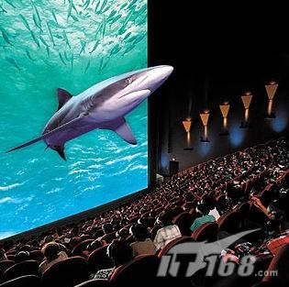
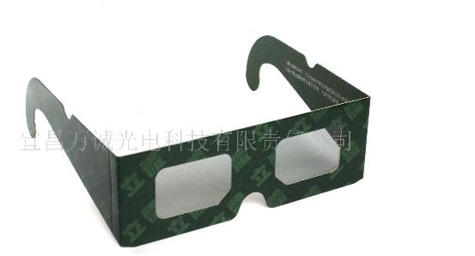

Slide 34
34
The summary of single medium uniform plane wave
Solution for the electromagnetic field complex vector ：
the direction of perpendicular to each other, and meet the Right-handed Rule
The amplitude of E is times of the amplitude of H.
using the electric field vector trajectory to judge the polarization characteristics(using the relationship between the two vertical component of the electric field)
Related concepts and physical quantities：
frequency、period、wavelength、phase constant、wave number、phase velocity、power velocity、dispersion、the phenomenon of skin、skin depth、surface impedance、attenuation constant 、 phase constant、propagation constant、polarization (linear, circular, elliptic polarization; left-handed and
right-handed polarization）
Key points of the problem solving method
basis on the direction of propagation , write the expression of electromagnetic field
Solving physical quantities, Accord to the definition and the law.

Slide 35
35
8.2 Plane Waves in Lossy Media
The ideal dielectric
Conductive medium

Slide 36


36
1. Uniform Plane Wave in Conductive Medium
Given by，
then uniform plane wave along the z direction is：
Amplitude attenuate in the form of index , is evanescent wave
The instantaneous electric field as
is propagation constant of EMW ，unit：1/m
is attenuation factor， is attenuation constant，unit：Np/m (nepers per meter)
is phase factor ， is phase constant，unit：rad/m（radian per meter）

Slide 37
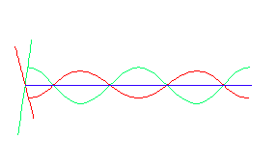
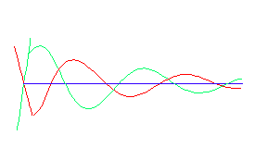
37
The corresponding magnetic field
The phase of Magnetic field is different with electric field , and lag its.
intrinsic impedance
intrinsic impedance is complex
E and H in Ideal dielectric
E and H in Conductive Medium

Slide 38
38
propagation parameters
Phase velocity is not only related with the medium parameters, but also related to the frequency of EM waves

Slide 39
39
2. Uniform Plane Wave in Low loss dielectrics (Special case)
Low Conductive Medium
The propagation characteristics of uniform plane wave in low conductive medium
The phase constant of low loss dielectrics is approximation to the phase constant of ideal medium

Slide 40
40
3. Uniform Plane Wave in Good Conductor (Special case)
Good Conductor：
parameters of good conductive medium
phase velocity：
wavelength：

Slide 41
41
intrinsic impedance
Corresponding the EM wave in good conductor, the phase of magnetic field is lagging with an angle of 45°compared with electric field
skin effect：Since the attenuation constant is larger over higher frequency, and The high frequency EM wave can only exist in the surface layer of good conductor , it’s called the skin effect.
skin depth（δ )：
surface impedance （square resistivity ） ：
skin depth δ
In the conductive medium , is the surface impedance always equal to the intrinsic resistance ?

Slide 42

42
Cu：

Slide 43
43
Table 1 Skin depth and surface resistance of some metal materials
Material Name | Conductivity σ /(S/m) | Skin Depthδ /m | Surface ResistivityR_{S} /Ω
Silver | 6.17×10⁷
Red copper | 5.8×10⁷
Aluminum | 3.72×10⁷
Sodium | 2.1×10⁷
Brass | 1.6×10⁷
Stannum | 0.87×10⁷
Graphite | 0.01×10⁷

Slide 44
44
Summary for Plane Wave in Lossy Media
Solution for electromagnetic field complex vector ：
The phases of Electric field and magnetic field are different. In addition, electric field phase advance magnetic field phase in an angle of , and its amplitude is times of magnetic field’s .
Related physical quantities :
dispersion, skin effect, the skin depth, surface impedance，attenuation constant，phase constant, propagation constant, and result in low conductive medium and good conductors

Slide 45
45
Ex. 9.4 GHz uniform plane wave propagation in polyethylene (assuming that it’s lossless medium , εr = 2.26 ). The amplitude of magnetic field is 7mA/m , please get the phase velocity，wavelength , wave impedance and the amplitude of electric field.
Solution：from the question
So:

Slide 46
46
Ex. The amplitude of magnetic of uniform plane wave is 1/3π A/m , phase constant is
30 rad/m, spread in the air along the direction . If the direction of is , please write out the expression of , ,and the frequency and wavelength.
Solution：Based on cosine, write directly
As β=30 rad/m，so
so:

Slide 47
47
Ex. 100MHz uniform EM wave propagation in lossless medium (εr = 4, μr =1 ) along +Z . Electric field is .when t = 0 and z =1/8 m, the amplitude of the electric field is 10^{－4} V/m . Find the instantaneous value of electric and magnetic field.
Answer :Set the expression of the transient electric field intensity is
where
when t = 0、z =1/8 m ，the amplitude of the electric field is max ，

Slide 48
48
So
The instantaneous value of the transient magnetic field is:
Where
So

Slide 49
49
8.3 Flow of Electromagnetic Power and the Poynting Vector
1. Conservation of energy
The energy flowing into volume V= Increased energy in the volume V + Energy loss in the volume V
Question： How to use mathematical representation ？

Slide 50
50
Storage of Electromagnetic energy in the volume V
The energy density of electric field ：
The energy density of magnetic field ：
The total energy density of electromagnetic field ：
The total energy of electromagnetic field
in the volume V ：
Features：When the electromagnetic field changes with time, the electromagnetic field energy density at each point of the space also changes with time, which causes the flow of electromagnetic energy.
Conclusion: describe the relationship of
energy according to the storage energy
changed with time.

Slide 51
51
The mathematical representation for the conservation of energy ──Poynting theorem
According to
Subtract the above two equations:

Slide 52
52
The Poynting theorem and its physical meaning
Differential form (relationship for instantaneous power density) ：
Integral form (relationship for instantaneous power) ：
the power is flowing into volume V
（ New physical quantity ）
Electromagnetic power increased in the volume V
Power loss in the volume V

Slide 53
53
The Poynting vector (energy flow density vector)
It describes the characteristics of the electromagnetic energy transmission (flow) in the time varying electromagnetic field
Definition： ( W/m² )
Flow of power per unit area
Physical meaning ：
Direction of — The direction of electromagnetic energy transmission
Value of ——
it is the electromagnetic power per unit area at the perpendicular the transmission direction of the energy

Slide 54
54
2、Power density and Power flow density
The electric field energy and the magnetic field energy of uniform plane wave in ideal medium is equal.
Power density :
where,
Power flow density :
Relationship :
The energy velocity and the phase velocity of uniform plane wave in ideal medium is equal

Slide 55
55
Instantaneous energy density and energy flow density vector
Instantaneous power density relation：
Instantaneous power relation ：
Notice：
all the variables in the formula must be represented by real form.
the real form of each variable need to be used when doing calculation.

Slide 56
56
Ex： The calculation of the instantaneous Poynting vector
Ex： Calculation of the electric field energy density of instantaneous storage
When solving the problems ,the instantaneous expression of the field must be written ！
Ex：Calculation of instantaneous power density consumption

Slide 57
57
Average energy / power density and energy flow density vector
Time average definition of time functions：
it is a periodic function with time T

Slide 58
58
The average Poynting vector （ energy flow density vector）
When solving the problems ,the instantaneous expression of the source is not required to be written ！

Slide 59
59
Average electric field energy density
When solving the problems ,the instantaneous expression of the source is not required to be written ！

Slide 60
60
Average magnetic field energy density
When solving the problems ,the instantaneous expression of the source is not required to be written ！

Slide 61
61
Average Joule loss power density
When solving the problems ,the instantaneous expression of the source is not required to be written ！

Slide 62
62
Ex. The electric field intensityof plane wave in free space
find the average power of vertical cross a round plane (radius=2.5m) at z = z0.
Sloution：The complex expression of electric field is
The intrinsic impedance of free space is
Get the expression of magnetic field
So , the average Poynting vector is
The average power of vertical cross a round plane is

Slide 63
63
Ex. The complex expression magnetic field intensity of plane wave in air is
Where A is constant . Get the :1) ；2）wavelength and frequency；3）the value of A；4）The complex expression electric field；5）average Poynting vector .
Solution：（1）Due to ， So
So

Slide 64
64
（2）
（3）
（4）
（5）

Slide 65
65
Ex. Polarized （in the X direction ）waves propagating in sea along + z . The parameter of the sea is ε_{r} = 81 、 μ_{r} =1 、σ= 4 S/m , At z = 0, E_{x} = 100cos(10⁷πt ) V/m .Please work out ：
（1）The attenuation constant, phase constant, intrinsic impedance, phase velocity, wavelength and skin depth ；
（2）The distance of wave propagation, when he amplitude of the electric field intensity reduced to be 1/1000 of the value at z=0.
（3）The expression of instantaneous electric and magnetic field intensity at z = 0.8 m ；
（4）Average power per 1m² at z=0.8m 。
Sloution：（1）According to the problem
So
In this condition, the sea can be regarded as good conductor.

Slide 66
66
So , Attenuation constant
Phase constant
The characteristic
impedance
Phase velocity
Wavelebgth
Skin depth

Slide 67
67
（2） Let e^{-αz}＝1/1000， i.e. e^{αz}＝1000，can get the distance of wave propagation, when the amplitude of the electric field intensity reduced to be 1/1000 of the value at z=0
（3）According to the problem, the expression of instantaneous electric field intensity is
So at z = 0.8 m, the expression of instantaneous electric field is
the expression of instantaneous magnetic field is

Slide 68
68
（4）At z = 0.8 m ,the average Poynting vector
The average power acoss The average
power acoss 1m² is Pav = 0.75 mW
The curve of the skin depth of the sea changes with the frequency
It can be known that the EM wave attenuation is very fast, especially at high frequency, the attenuation is more serious. This has led to a lot of difficulties for the communication between the submarines. To have lower attenuation, the working frequency must be very low, but even at the low frequency of 1 kHz, the attenuation is still obvious.

Slide 69
69
Ex. In the electromagnetic measurement, in order to prevent the indoor electronic equipment from the outside world the influence of electromagnetic field，Copper plate can be used to construct shielding room, usually require copper thickness greater than 5δ . If the require frequency range is from 10KHz to 100MHZ , Calculate how thick copper plate at least。the parameter of Cu :μ=μ₀、ε=ε₀、σ = 5.8×10⁷ S/m。
Answer ：For the frequency range of low-end f_{L} =10kHz ，
For the frequency range of high-end f_{H} =100MHz ，

Slide 70
70
this shows , copper can be treat as good conductor in the required frequency range of ，
In order to satisfy a given frequency range of the shielding requirements，
The thickness of the copper plate at least should be

Slide 71
71
8.4 Normal Incidence at a Plane Conducting Boundary
Phenomenon：
In the space , at the side of the incident wave of electromagnetic wave added a reflected wave ; the transmitted wave can exist on the other side .
Plane of incidence
E
E
E
i
//
r
//
i
reflected wave
E
r
k
incident wave
k
θ
θ
r
i
i
r
E
i
⊥
E
⊥
r
x
interface
E
θ
t
//
y
t
E
t
The incident way：
vertical incidence 、
oblique incidence
E
t
⊥
k
z
t
transmitted wave
Medium：
Conductive medium, ideal conductor, the ideal dielectric

Slide 72
72
The basic problem：
To solve the incident wave and transmission wave electromagnetic fields respectively
Incident wave space：
Transmission wave space：
problem：
Plane of incidence
E
Known:
E
E
i
//
r
//
i
reflected wave
E
r
k
incident wave
k
θ
θ
r
Solve:
i
i
r
E
i
⊥
E
⊥
r
x
interface
E
Find the direction and the value of the corresponding physical quantities.
θ
t
//
y
t
E
t
E
t
⊥
k
z
t
transmitted wave

Slide 73
73
Analysis Method ：
Establish the relationship of various physical quantities on the boundary
boundary condition
transmitted wave (unknown)
incident wave（known）
＋reflected wave（unknown）
Plane of incidence
E
E
E
i
//
r
//
i
reflected wave
E
r
k
incident wave
k
θ
θ
r
i
i
r
E
i
⊥
E
⊥
r
x
interface
E
θ
t
//
y
t
E
t
E
t
⊥
k
z
t
transmitted wave

Slide 74
74
Uniform plane wave vertical incidence to the interface between two different media plane
feature：
The reflection wave propagation along the -z direction. the transmitted wave propagation along the +z direction
the electric field only has x component
(Determine the direction of physical quantities of reflected and transmission wave !)
why？

Slide 75
75
problem：solve the amplitude of reflected wave and transmission wave
method：write out the expression and use the boundary conditions
Establish coordinate system as shown
x
at z < 0 region，the parameters of conductive medium1
medium1：
medium2：
at z > 0 region，the parameters of conductive medium 2
y
z
Assuming that the incident wave is linear polarized wave at x direction
without loss of generality ！why？
How is for circular polarized wave？

Slide 76
76
incident wave in medium 1：
reflected wave in medium 1 ：
transmitted wave in medium 2：

Slide 77
77
where：
Reflection coefficient on the interface
Transmission coefficient on the interface

Slide 78
78
medium 1 is ideal dielectric，σ₁＝0
medium 2 is ideal conductor，σ₂＝∞
x
medium1：
medium 2：
then
y
z
so
on the interface，the Phase difference between the incident wave and reflected wave is π
z = 0
incident wave in medium 1：
reflected wave in medium 1：

Slide 79
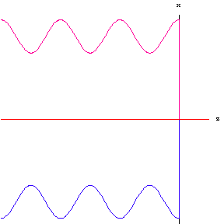
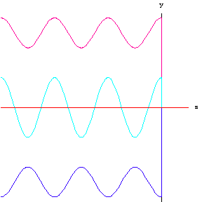
79
the electromagnetic field of total field in miduim 1
Instantaneous value form
the relationship of the total fields：
time phase difference isπ/2
space length difference is λ/4
incident wave
total wave
reflected wave
electric field intensity
magnetic field intensity

Slide 80
80
The relevant physical quantities and concepts
the average poynting vector of the total field is :
the induced current density on the surface of the ideal conductor
travelling wave：Electromagnetic wave propagated along a certain direction in the space (moving)
Standing wave： Electromagnetic wave is not propagated in the space，there are antinodes and nodes at fixed point.
travelling-standing wave ：part of the electromagnetic wave in space spread, and part of don't spread.

Slide 81
81
incident wave
travelling wave along z
total
wave
standing wave
reflected wave
travelling wave along -z
electric field intensity
magnetic field intensity
the point of antinodes ( the point of the maximum value of electric field)：
The distance from conducting plate is
(n = 0,1,2,3,…)
the point of nodes（the point of the minimum value of electric field）：
The distance from conducting plate is
(n = 0,1,2,3,…)

Slide 82
82
The electromagnetic field in the both sides of general medium interface
where：
Reflectance coefficient on the interface
Transmission coefficient on the interface

Slide 83
83
8.5 Normal Incidence at a Plane Dielectric Boundary
x
Assume that two kinds of medium are the ideal dielectrics，σ₁= σ₂= 0
dielectrics 1：
dielectrics 2：
so
y
z
z=0
Discuss
when η₂ >η₁，Γ > 0，the electric field of reflected wave and incidence wave is the same in phase.
when η₂ <η₁，Γ < 0， the electric field of reflected wave and incidence wave is reverse in phase.

Slide 84
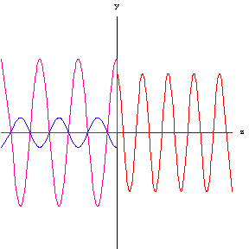
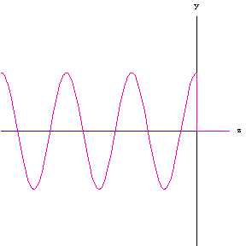
84
x
incidence wave
transmitted wave
reflected wave
total：
travelling-standing wave
x
— the electric field of standing wave
— the electric field of travelling wave
z
— the electric field of total field

Slide 85

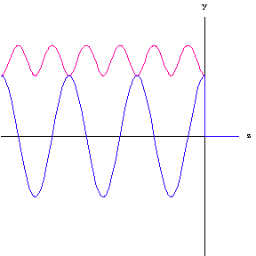
85
The amplitude change of the total electric field in the ideal dielectric
optically denser medium（Γ < 0）
z =－(n/2+1/4)λ₁
z =－nλ₁/ 2
x
——the amplitude of the total electric field
z
—— the electric field of total field

Slide 86
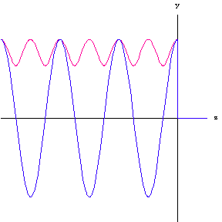
86
The change rule in the space for the amplitude of the total electric field in the ideal dielectric
Light thin medium（Γ > 0）
z =－nλ₁/ 2
z =－(n/2+1/4)λ₁
x
——the amplitude of the total electric field
z
—— the electric field of total field

Slide 87
87
Question and Thinking：
1） Whether the amplitude of travelling wave in the ideal dielectric will by change with different space position?
2）What is the standing wave?
3）Reflected wave is travelling wave or standing wave?
4）what wave is the total field wave？
5）Why the amplitude of total field will by changed with different space position?
6）What is the reason for standing wave？
reflection standing wave

Slide 88
88
Introducing a new quantity to express standing wave or the degree of reflection
standing-wave ratio (SWR) S
Discuss
when Г＝0 , S ＝1, travelling wave.
when Г＝±1 , S = ∞ , Pure standing-wave.
when , 1< S <∞ ，Mixed wave. With the value of S increase, the component of standing wave increase ,and the component of the travellling wave reduce.

Slide 89
89
Electromagnetic energy flow density
The average power density propagate along Z in the dielectric 1
The average power density in the dielectric 2
due

Slide 90
90
Ex. uniform plane wave propagate along +Z, the electric field intensity vector is
Find:
（1）the corresponding magnetic field intensity ;
（2）if on the direction of propagation at the point of z = 0，place an infinite plate of ideal conductor, write out the electric and magnetic field intensity in the z < 0 region ;
（3）the electric current density on the surface of ideal conductor.
Solution: (1) The expressions of the complex of the electric field intensity
so

Slide 91
91
the instantaneous expression:
(2) the electric field of the reflected wave is
the magnetic field of the reflected wave is

Slide 92
92
the expressions of electric and magnetic field of the total field in the z < 0 region, respectively
(3) the electric current density on the surface of ideal conductor is

Slide 93
93
Ex. In the free space, uniform plane wave vertical incidence to the semi infinite plane of lossless dielectric. Given the SWR=3 in the free space, the wavelength in the dielectric is 1/6 of that in the space. The point of the minimum value of standing wave is on the interface. Work out the relative permeability and relative permittivity of the dielectric.
Answer ：Due to SWR is
as the point of the minimum value of standing wave is on the interface
as reflection coefficient
where
because the wavelength
in 2 region

Slide 94
94
Ex. The electric field of incidence wave is .
it vertical incident to the interface at z = 0 from the region (z < 0) of air (μ_{r}=1 ε_{r} = 4) . Find the electric and magnetic fields in the region of z > 0.
Solution: the intrinsic impedance in the z > 0 region
x
medium 1
medium 2
Transmission coefficient
y
z

Slide 95
95
phase constant
so

Slide 96
96
Ex. Given the parameters of medium 1 are ε_{r1}=4、μ_{r1}=1、σ₁=0 ； medium 2 : ε_{r2}=10、μ_{r2} = 4、σ₂= 0 . A uniform plane wave which its angular frequency is ω＝5×10⁸ rad /s vertical incidence to the interface from medium 1 . The incidence wave is linear polarized wave in the direction of x axis , when t＝0、z＝0 ，the amplitude of incidence wave is 2.4 V/m . Find:
(1) β₁ and β₂ ；
(2) reflection coefficient Г₁ andГ₂ ；
(3) the electric field in the region 1 ；
(4) the electric field in the region 2 .
Solution:（1）

Slide 97
97
（2）
（3） the electric field in the region 1

Slide 98
98
or
（4）
so

Slide 99
Summary
99
In the space of incidence wave there are incidence wave and reflected wave , only transmitted wave in the transmitted space
The direction of incidence、reflected and transmitted wave both in the normal direction of the interface.
The direction of electromagnetic field of incidence、reflected and transmitted wave both in the same coordinate axis direction.
Incidence, reflection and transmission wave respectively satisfy the propagation rules in a single dielectric space.
Related concepts and physical quantities：
Travelling wave 、standing wave 、travelling-standing wave, reflection coefficient 、 transmission coefficient, standing wave coefficient (SWR), antinodes, node, light dense medium, light thinner medium
Key points for the problem solving method:
Basis on the incidence wave, written expressions of reflected wave and transmitted wave respectively. Then analysis and discuss the related total wave.
According to the definition and the law to work out the physical quantities.

Slide 100
Homework
8-5, 8-6, 8-12, 8-17, 8-22, 8-27

